Slide 1
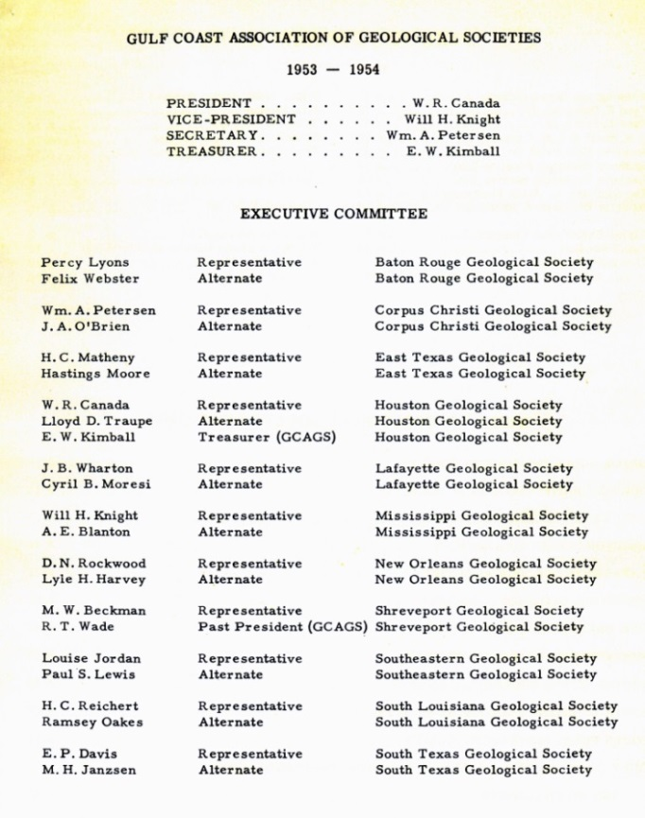
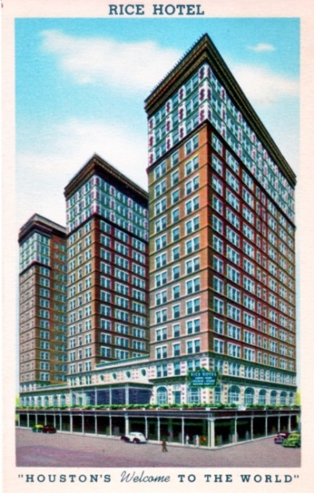
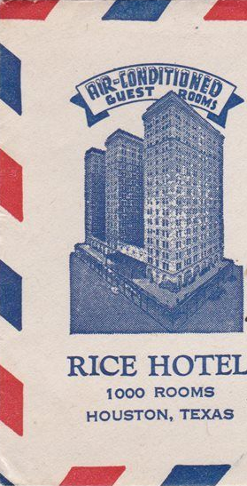
4th Annual GCAGS
Meeting
November 3-5th 1954
Rice Hotel, Houston
First time the GCAGS Annual Meeting was held in Houston
Held again in Houston
1959
1965
1973
1982
1991
2000
2008
2015
Jeff Spencer
GCAGS Historian

Slide 2
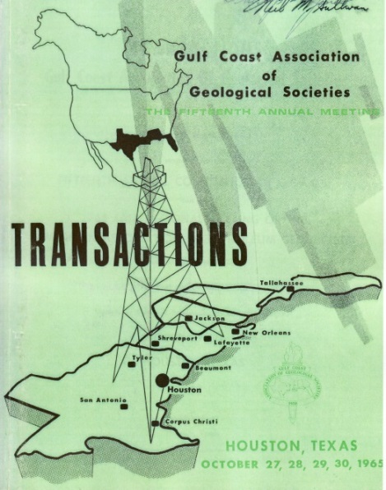
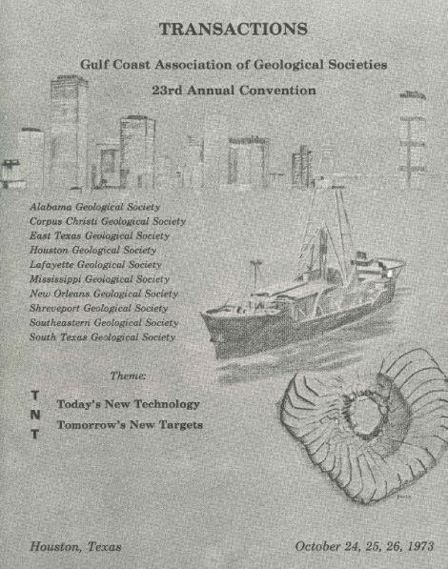
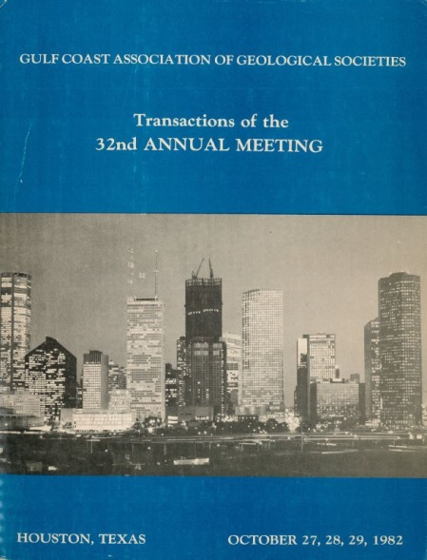
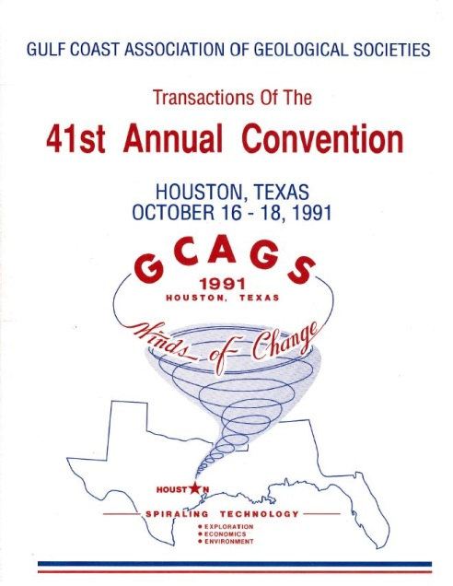
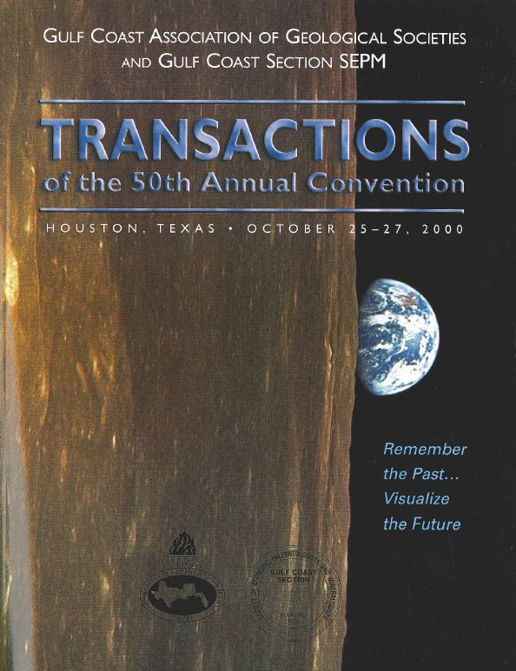
Additional GCAGS Conventions - Houston
1959
1965
1973
1982
1991
2000
2008

Slide 3
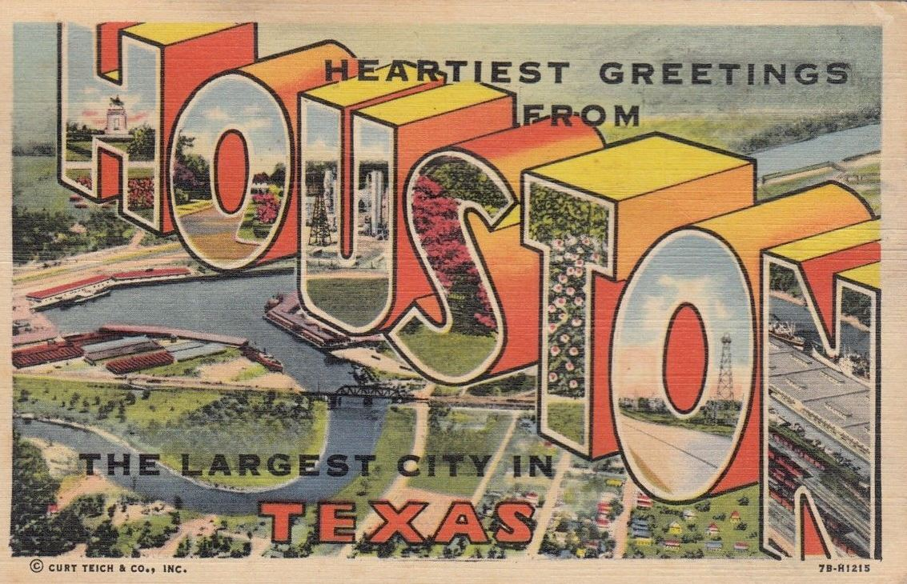
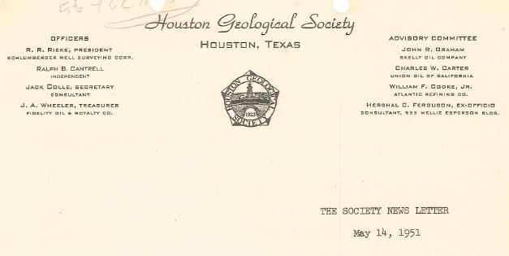
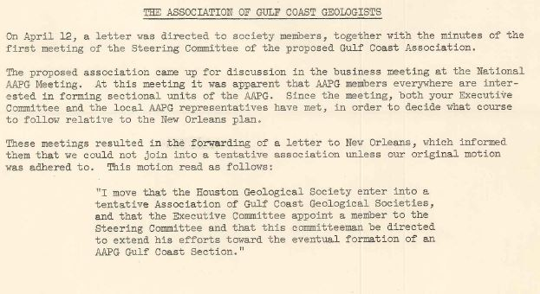
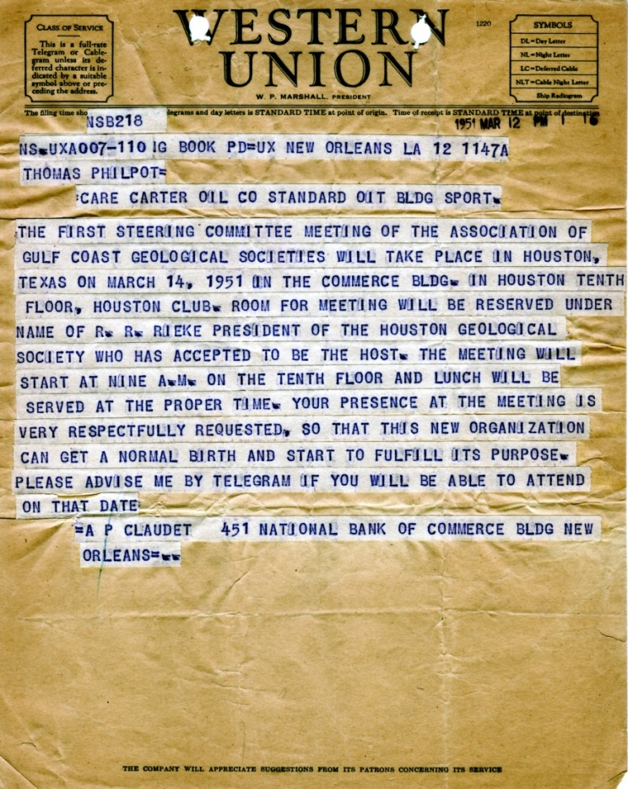
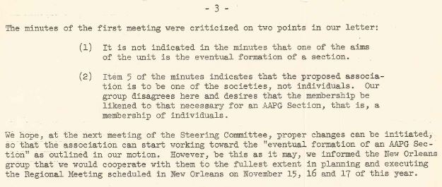

Slide 4
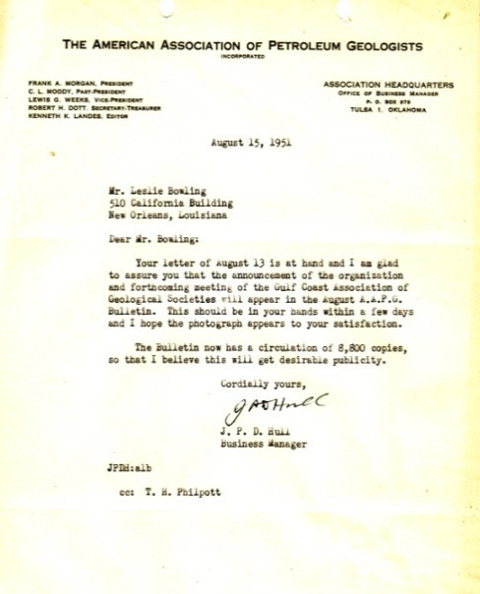
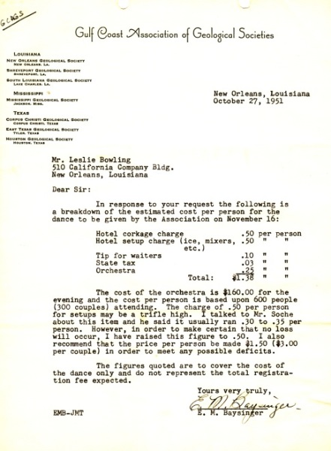
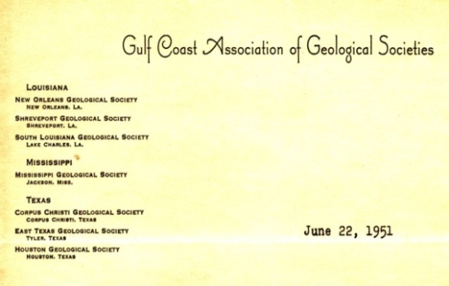
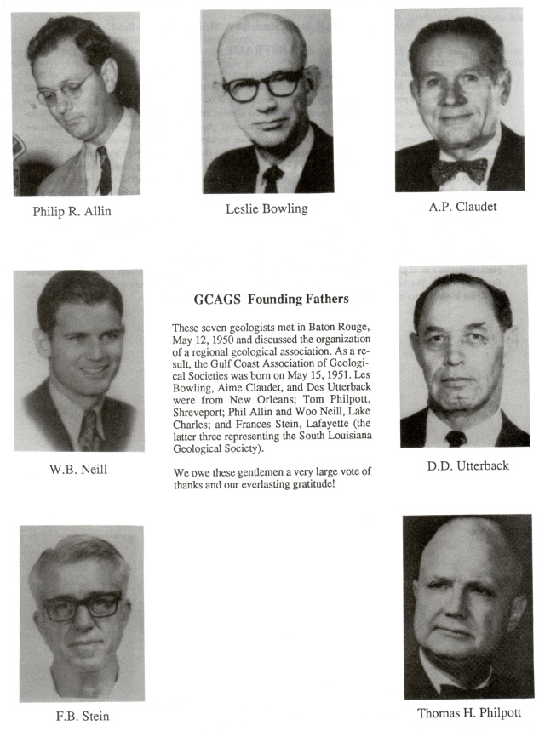
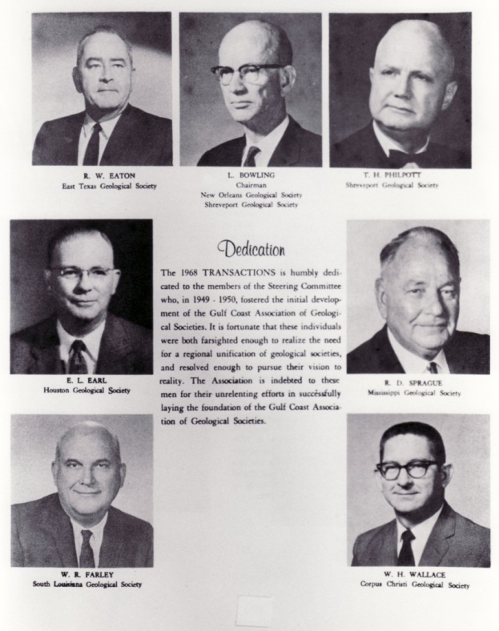
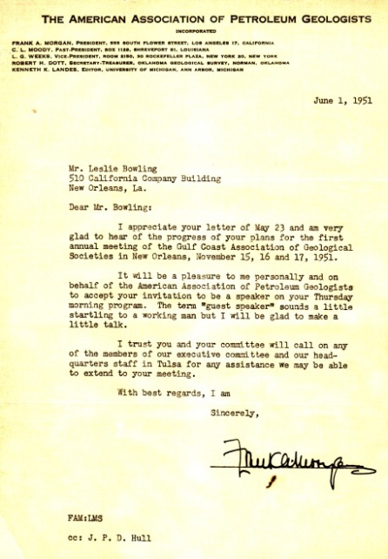
A sample of letters associated with the formation of the GCAGS and the first annual meeting - 1951
1st Annual Meeting cover
AAPG Bulletin to advertise
1951 dance, drinks & tips
First GCAGS letterhead
Pope, David E., 1991, The GCAGS, 1951-1990. A Salute to Forty Years of Progress, GCAGS Transactions, v. 41, p. 516-523.
AAPG President’s acceptance to attend first annual meeting of GCAGS
Organizational Steering Committee
from 1968 Transactions Dedication

